Slide 1
D2D Copyright & Licence
C. Kreutz, A. Hauber

Slide 2

Issue #163
https://github.com/Data2Dynamics/d2d/issues/163

Slide 3

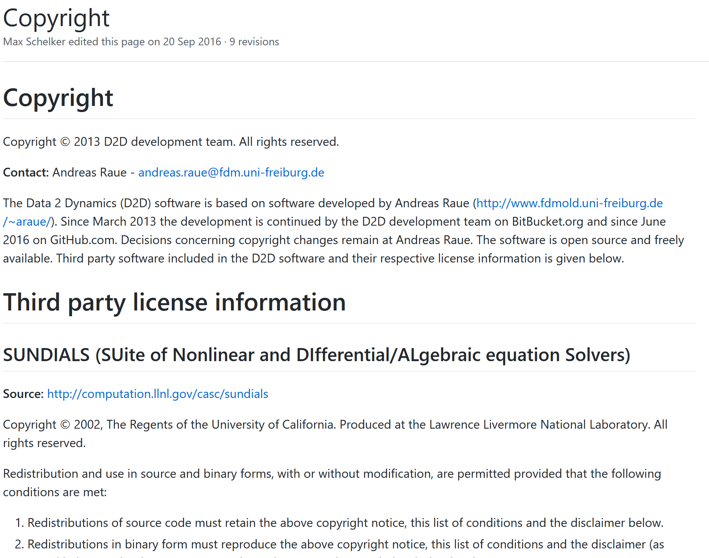

Existing Statements
https://github.com/Data2Dynamics/d2d
https://github.com/Data2Dynamics/d2d/wiki/Copyright

Slide 4
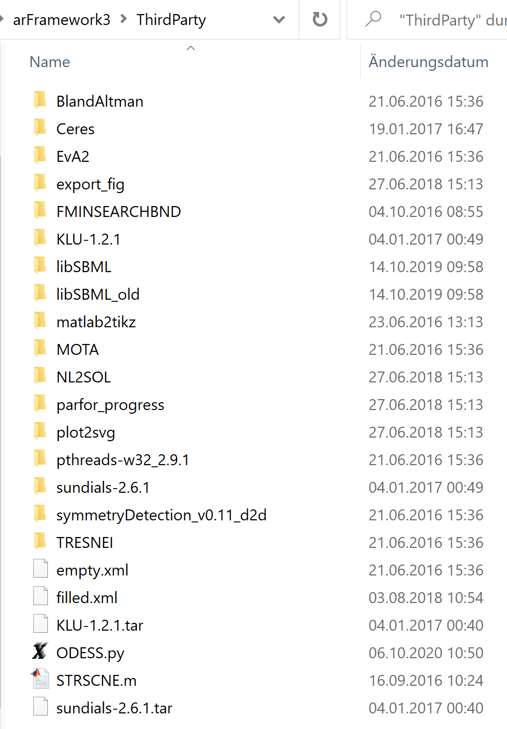
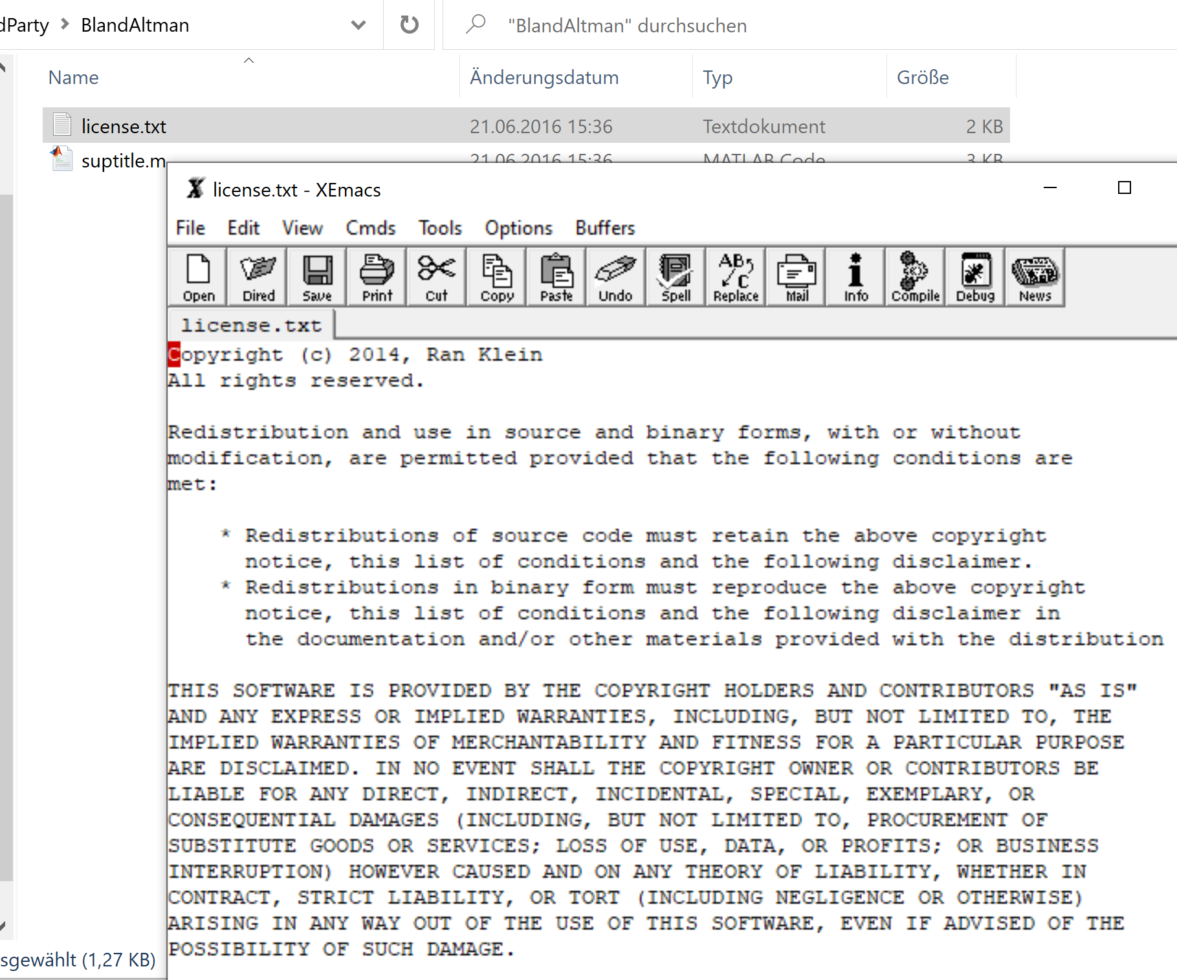
Third party code

Slide 5
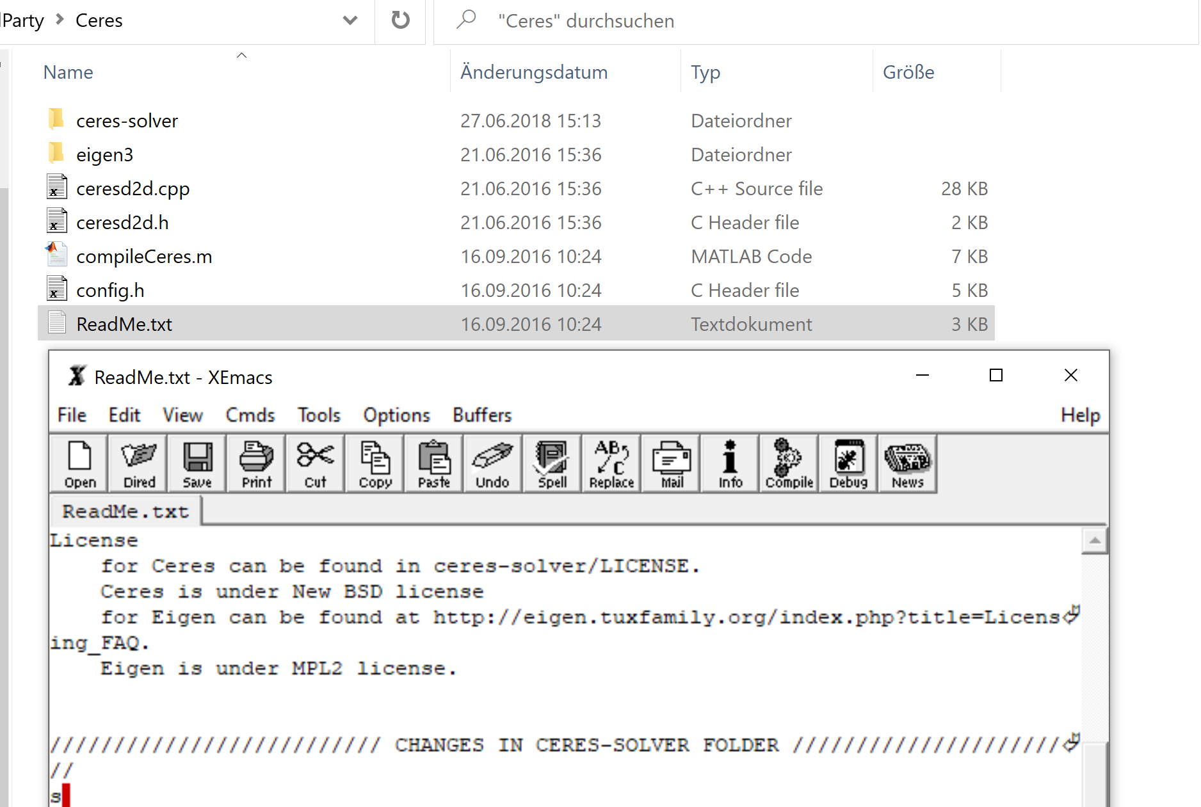
Third party code

Slide 6
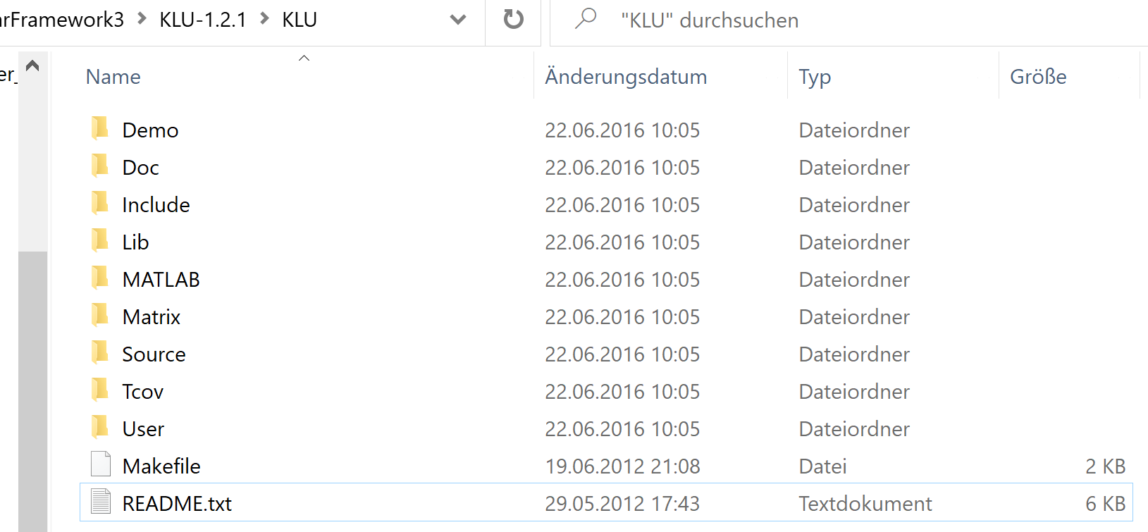
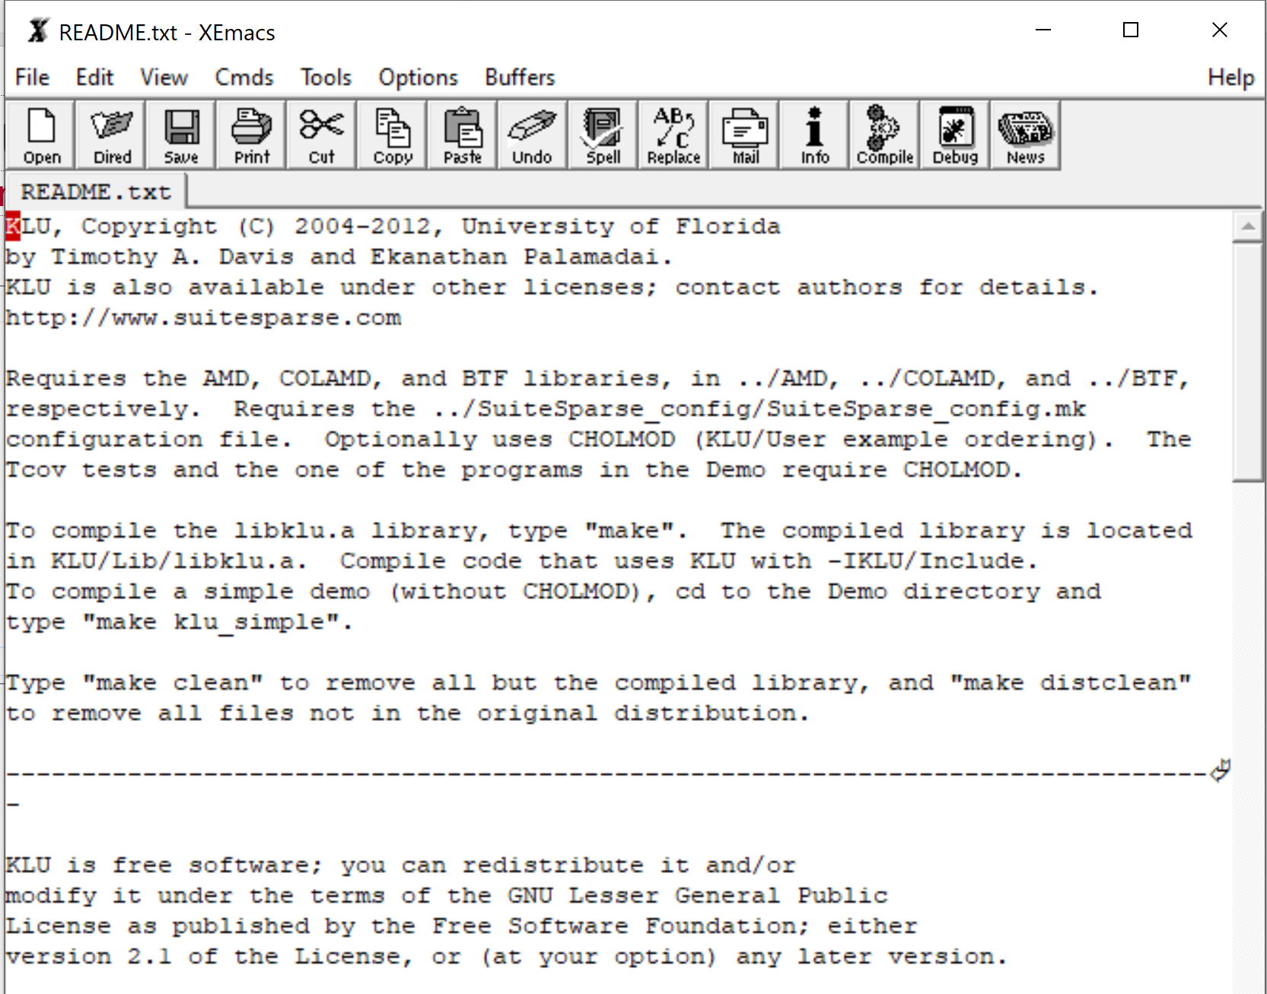
KLU

Slide 7
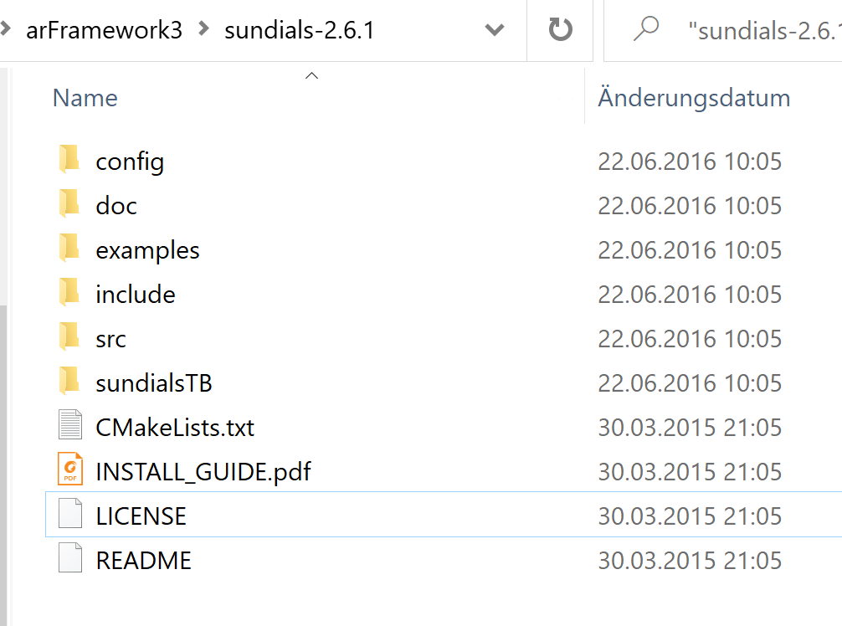
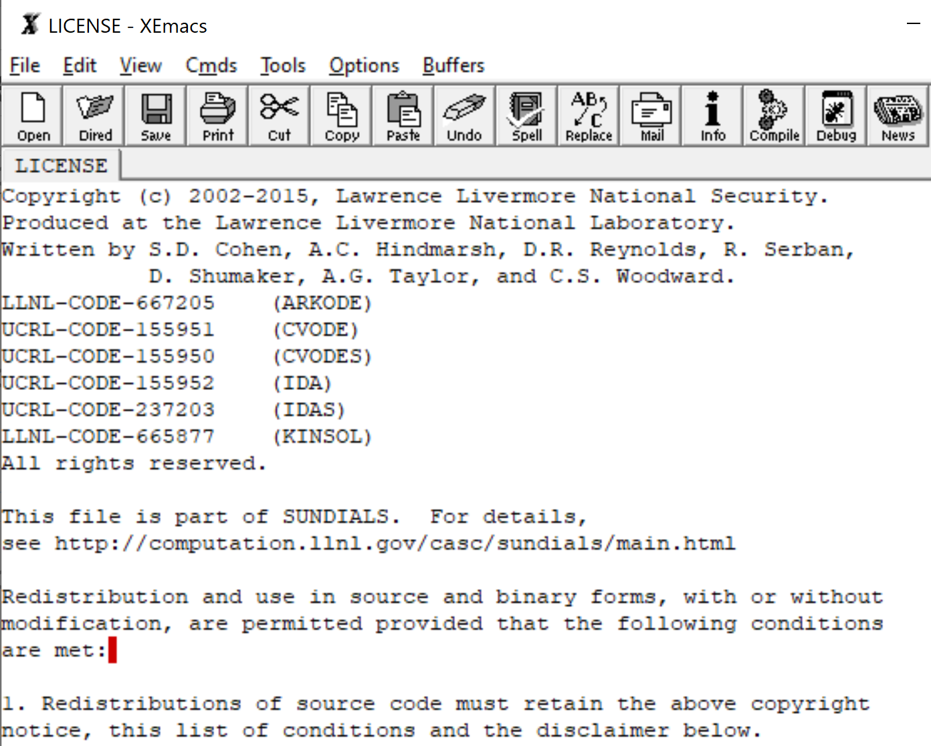
SUNDIALS

Slide 8
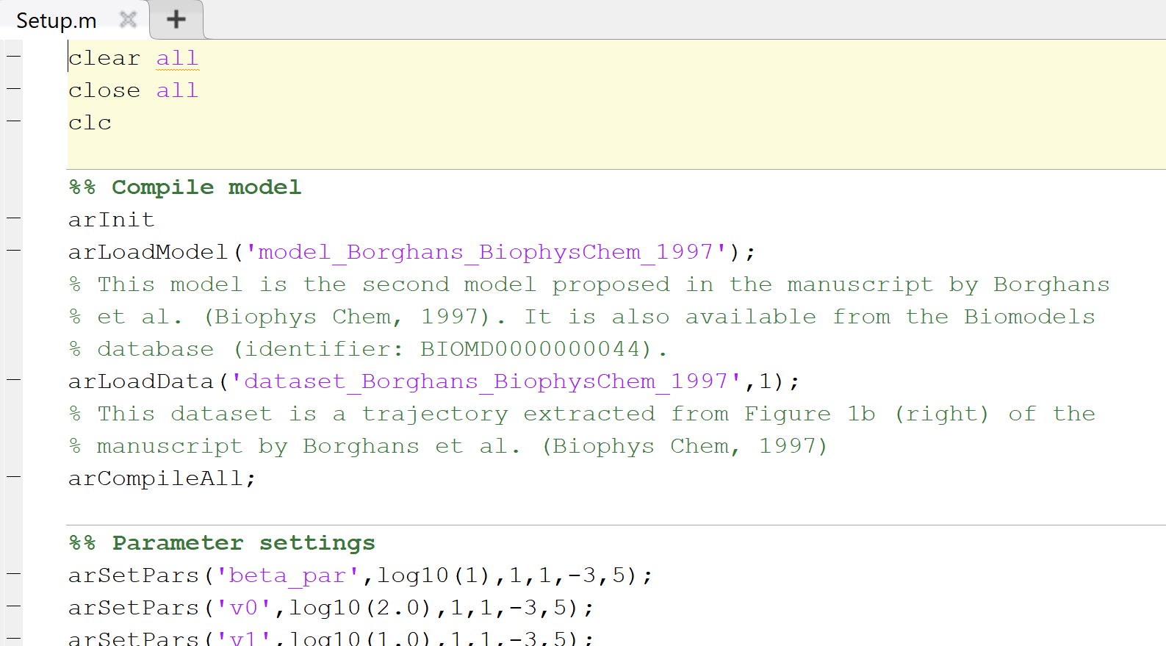
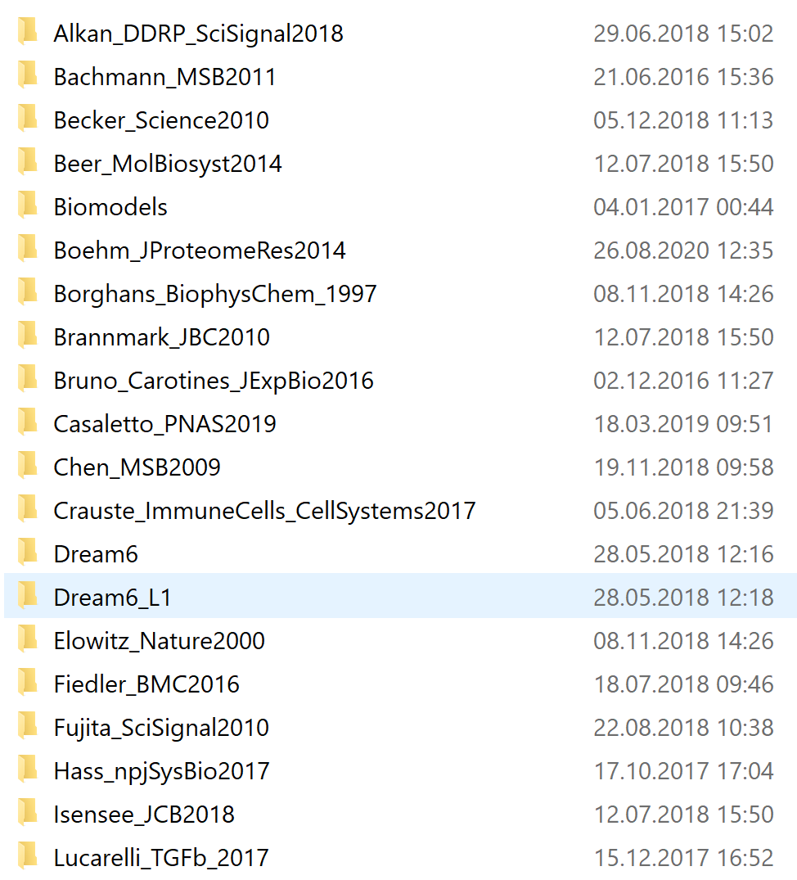
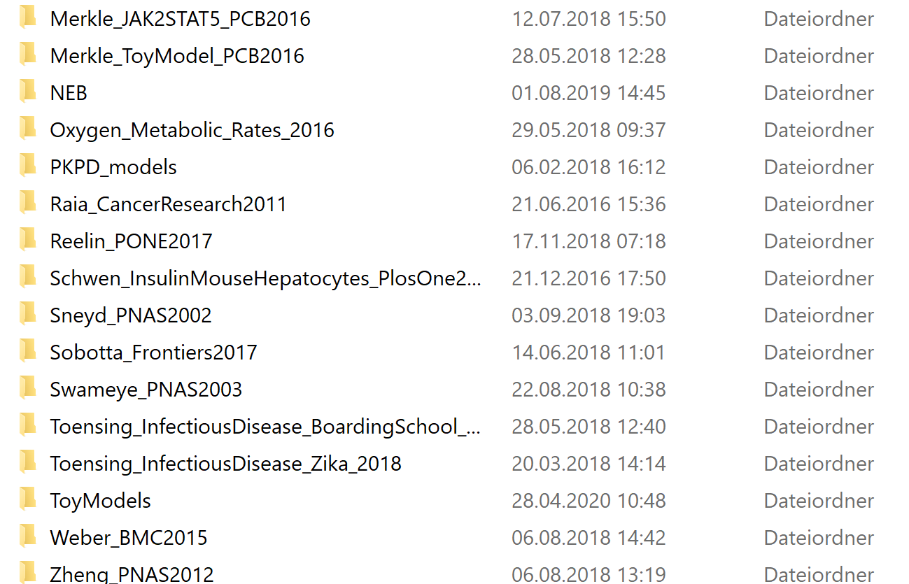
Example models
d2d\arFramework3\Examples
Own models and models
from literature

Slide 9
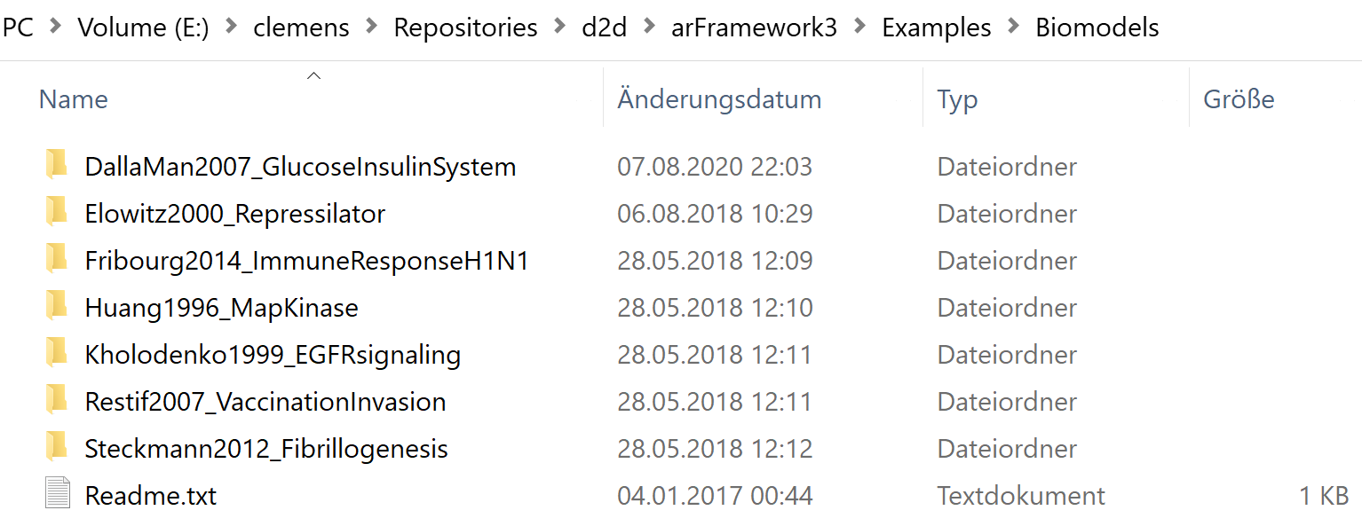

Examples from Biomodels Database

